Slide 1
Brahma Chickens

Slide 2
History
Place of Origin: Brahma’s were created in California by crossing a Chinese Shanghai Cochin with a Chittagong (Malay) from India, both Asiatic breeds in the 1840s.
Admitted in APA:1874

Slide 3
Breed Standards
Class: Asiatic
Size of Standard Cock: 12 lb. (5.5 kg)
Size of Standard Hen: 9.5 lb, (4.3 kg)
Comb Type: medium sized pea comb
Wattles & Comb: All red
Eyes: Large, round, deep set.
Beak: stout and well curved.
Shanks & Toes: Yellow
Colors accepted in APA Standard: Light, Dark, and Buff.

Slide 4
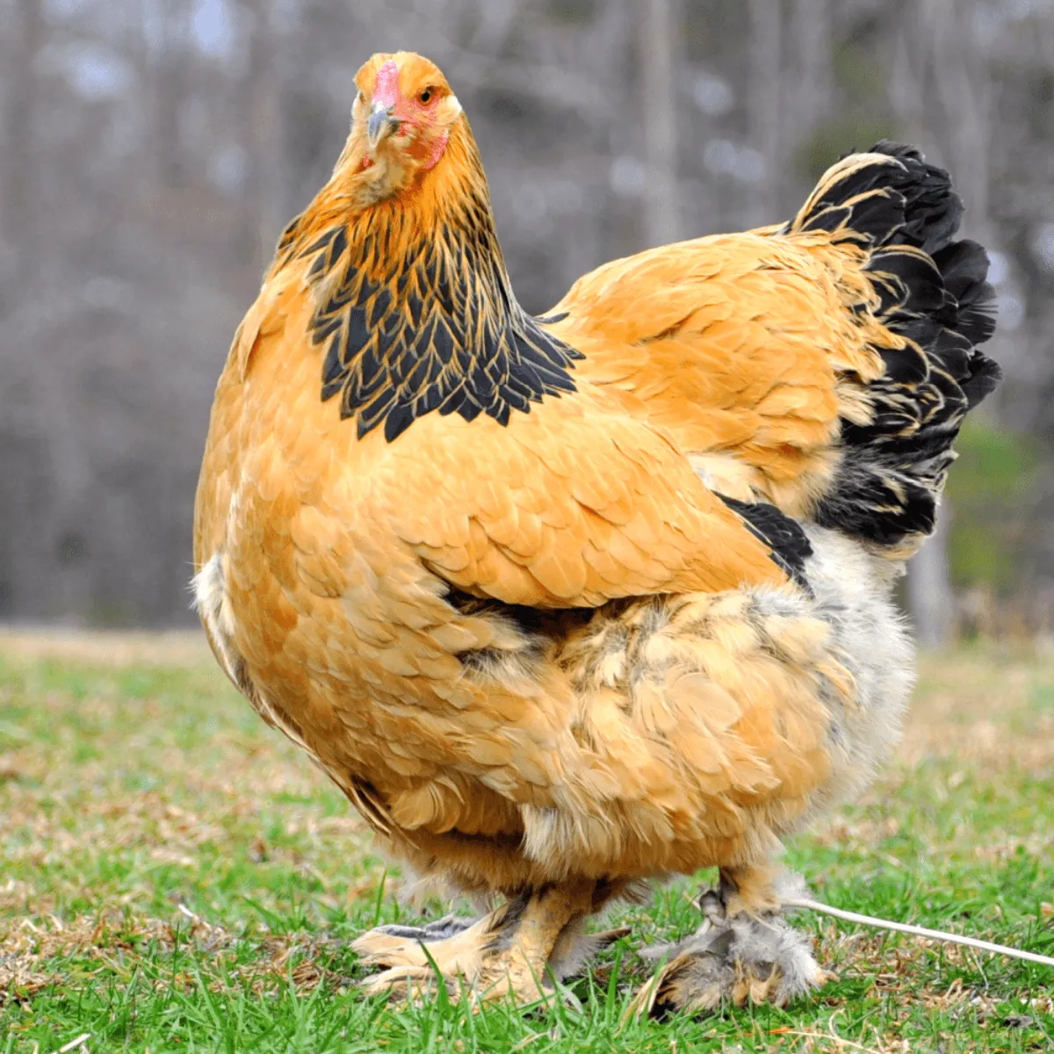
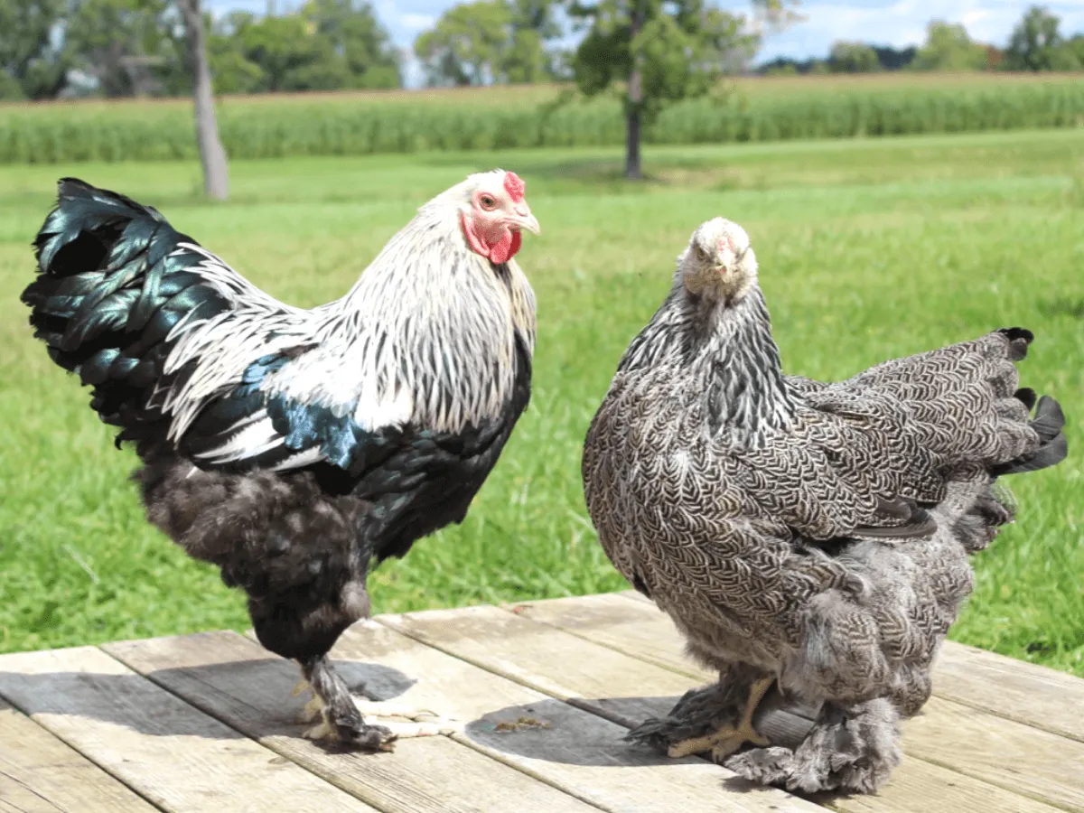
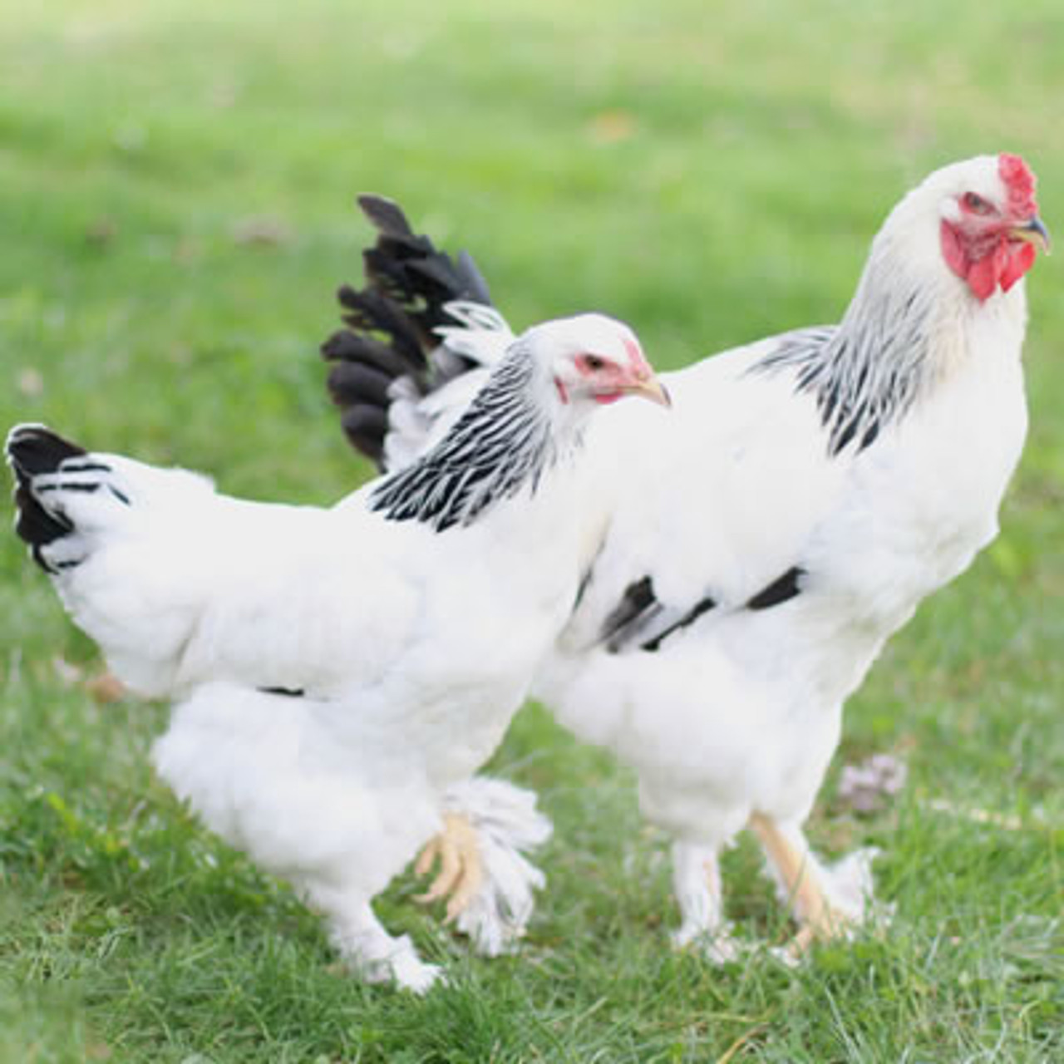
Varieties
Light Hen and Rooster
Buff Hen
Dark Rooster & Hen

Slide 5
Health and Care
Vaccines- to prevent diseases from spreading across your flock
Marek’s Disease- can cause tumors, blindness, or paralysis
Fowl Pox- lesions on the skin or oral cavity
Coccidiosis Vaccine- prevent intestinal parasite
Housing- Chicken Coop and Run
Space per chicken- 4 sq feet of coop space per chicken and 10 sq feet of run space
Chickens need nesting boxes (1box per 4 chickens) and roosts inside their coops (1ft space per chicken)
Access to food and water all the time

Slide 6
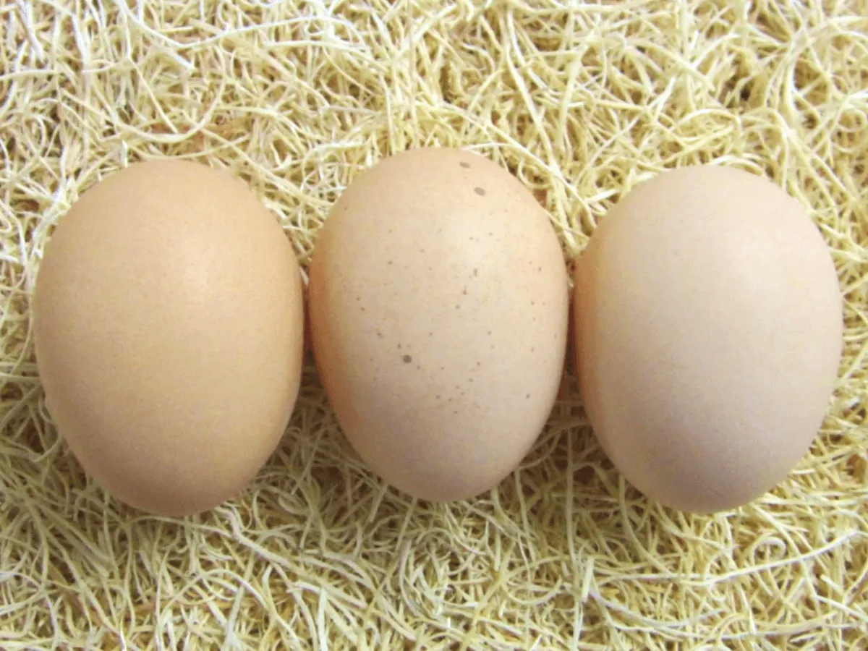
Cool Facts
Lay 3-4 eggs a week
Tan to light brown eggs
Average lifespan 5-8 years
Winter layers
One of the largest breeds

