Slide 1
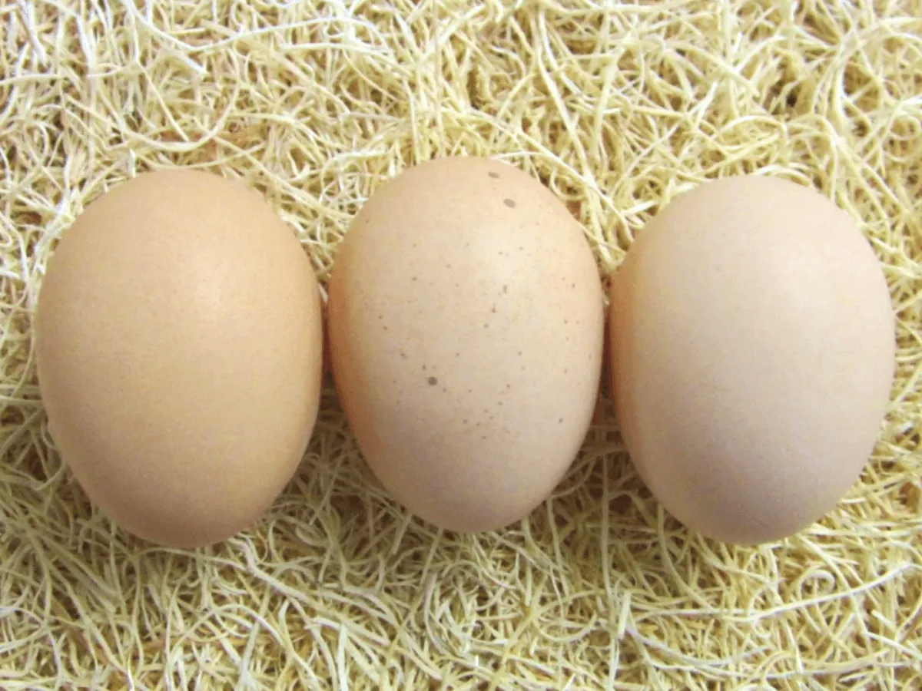
Cool Facts
Lay 3-4 eggs a week
Tan to light brown eggs
Average lifespan 5-8 years
Winter layers
One of the largest breeds

